Slide 1
Frank Jiang
WhatsApp: +8618702397544
Skype:Frank@smthelp.com
Email:Frank@smthelp.com
www.smthelp.com

Slide 2
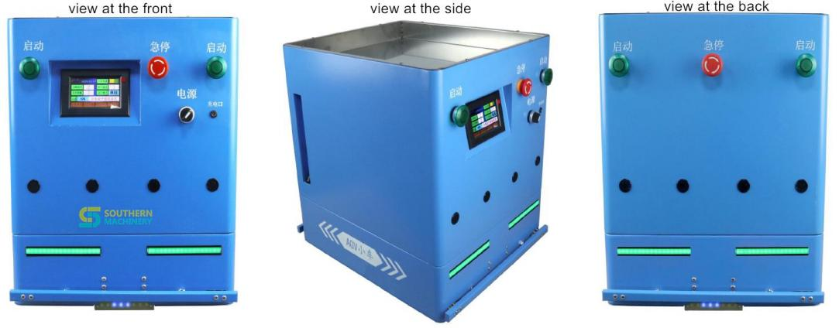
AGV Robot for Soldering Pallet
u This AGV robot is especially designed and produced to
transport PCB soldering pallet at the electronic manufacturing shopfloor.
u With tailored dimension, the AGV is suitable for SANMINA’s soldering pallet and floor space.
u It can drive in 3 modes. Straight-line driving, Turn circle
driving and Branch route driving. Flexible to support different production layout.
u Power supply in 2 ways. Lithium battery or DC charging. Long service life 3~5 years. Low maintenance cost.
www.smthelp.com

Slide 3
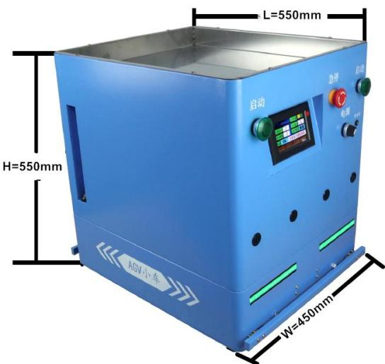
Specification
AGV Outer dimension
Brand/model | Southern Machinery: S-AGV60C
Navigation method | Magnetic strips; forward and backward
2 driving modes of standard configuration | Straight-line driving + Turn circle driving
1 driving mode of optional configuration | Branch route driving
Max. loading capacity | 60KG
Max. speed rate | 20-45m/minute, adjustable(about 0.4 minutes to drive 17m for SANMINA)
Min. RADIUS OF TURNING CIRCLE | 0.8m
Accuracy for stopping | 2cm
Power supply in 2 ways available | Lithium Battery 24V20AH replacement and DC charging
Power life | Can drive more than 15 hours if fully charged
Standby time without any loading and driving | 200 hours
Charging time | 5 hours
AGV outer dimension | LxWxH=550x450x550mm
Plate dimension | LxWxH=520x430x50mm(where soldering pallet is placed)
AGV net weight | about 35KG
Parament setting | touch screen LCD or remote control
Drive | Brushless Motor Differential ratio
Sensors for obstacles detect | ultrasound 8 sensors in total
www.smthelp.com

Slide 4
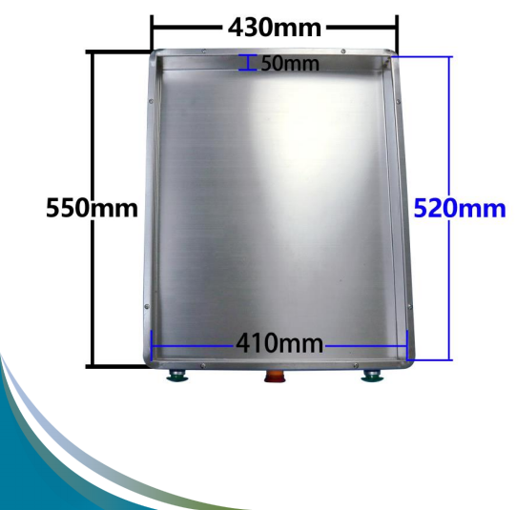
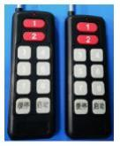
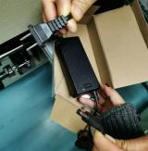
Specification
AGV Plate where soldering pallet is placed.
Remote control | with 2
Station choice | AGV
Remaining power display | it is lack of
Spare parts included in the package | navigation cards+
Warranty | AGV-
controls in the package
can stop at Max.20 target stations; RFID
shown at the touch screen; alarm when electricity
strips 20m + 1x charger + 20 RFID
10 decelerating cards when turning
1 year; Battery and charger-1 year
Comments: 1 Battery has already been installed in the AGV
Remote control
Charger
RFID cards
navigation strips
www.smthelp.com

Slide 5
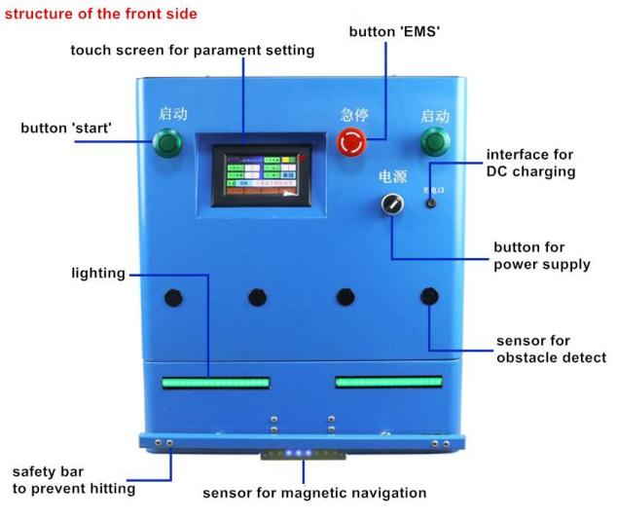
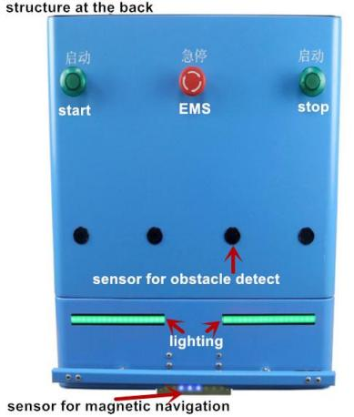
Structure
Comments: all button and screen display can be in English.
www.smthelp.com

Slide 6
Detail Clarification
Standard configuration of driving modes includes 1 and 2 Optional configuration is mode 3
www.smthelp.com

Slide 7
Detail Clarification
Standard configuration of driving modes includes 1 and 2 Optional configuration is mode 3
www.smthelp.com

Slide 8
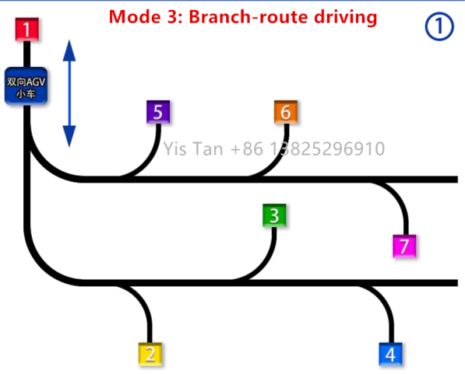
Detail Clarification
Optional configuration is mode 3: Branch-route
In this mode, you can do target settings to make AGV skip obstacles.
It is a wonderful driving optimization. Very flexible.
www smthelp.

Slide 9
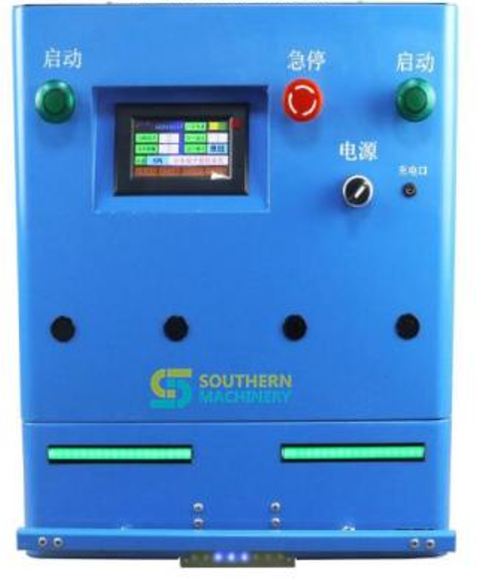
WIFI controller Introduction
We use an external w-100 wifi control module to enable the machine to access any supported WiFi LAN network.
We can access the machine's ip address through any terminal device, which can be easily realized by our proprietary control software.
Wifi with Open API for data server management centralization
www.smthelp.com

Slide 10
AGV with WIFI control demo
With our agv trolley with wifi function you can freely realize all the functions of agv trolley on PC and other terminal devices.
This video shows the way to control AGV.
www.smthelp.com

Slide 11
IP connection setting
The PowerPoint video here shows you how to access the internal control program of an AGV vehicle through an open API interface and use our own software to control the vehicle.
www.smthelp.com

Slide 12
Best After-sales service
— 7x24 Worldwide Support
— Free Installation/ Training
— 1 day lead-time (spare parts) — 1 Month customize solution
www.smthelp.com
www.smthelp.com

Slide 13
WELCOME INQUIRY
Please visit www.smthelp.com
Find us more https://www.facebook.com/autoinsertion
Know more our team https://cn.linkedin.com/in/smtsupplier
Welcome to our factory in Shenzhen China
See more machine working video, please Youtube
Auto Insertion
Google
Auto+insertion, to get more information
Looking forward to your email
yis@smthelp.com
www.smthelp.com
www.smthelp.com

